Slide 1

Pro Forma Income Statement
Project Analysis

Slide 2
Project Valuation Procedure
We first estimate operating income (EBIT) from a pro forma income statement of the project
Then we convert from operating income to operating cash flow (OCF)
Finally we calculate total cash flows
Operating cash flow
Capital expenditure (CAPEX)
Change in net working capital
Salvage value

Slide 3


Pro Forma Income Statement
Stand-alone principle!

Slide 4
Pro Forma Income Statement
Stand-alone principle!
Example:
Revenue | 800.0
Operating Costs | 400.0
Depreciation | 100.0
EBIT | 300.0
Taxes (@25%) | 75.0
Net Income | 225.0

Slide 5
Annual Depreciation Cost
If we use the straight-line depreciation method,
Initial value − Salvage value
D =
Number of years
- Example: You have purchased equipment for $1,000. The project’s life is 5 years. Salvage value is expected to be zero.
$1,000 − $0
D =
= $200
5

Slide 6
Project Description
Suppose you are considering the following project:
Your company has just developed a bubble gum that enables chewers to “fly” momentarily
You have already spent $5,000 developing the
product
You need to invest $6,500 today to build the production facility
The project’s life is 6 years

Slide 7
Project Description
Suppose you are considering the following project:
The production facility is depreciated to $500 using the straight-line method
The actual resale value of the facility is expected
to be $1,000 at the end of Year 6
To produce this special bubble gums, you have to give up another project worth $1,000

Slide 8
Project Description
Suppose you are considering the following project:
In the first year of operation (Year 1), the sales volume will be 500 packs
Sales volume is expected to grow by 5% annually
Unit price will be fixed at $15
Each year the operating cost will be 60% of revenue
Each year the net working capital requirement is 15% of revenue

Slide 9
Project Description
Suppose you are considering the following project:
Tax rate is 25%
The appropriate discount rate of the project is 20%

Slide 10
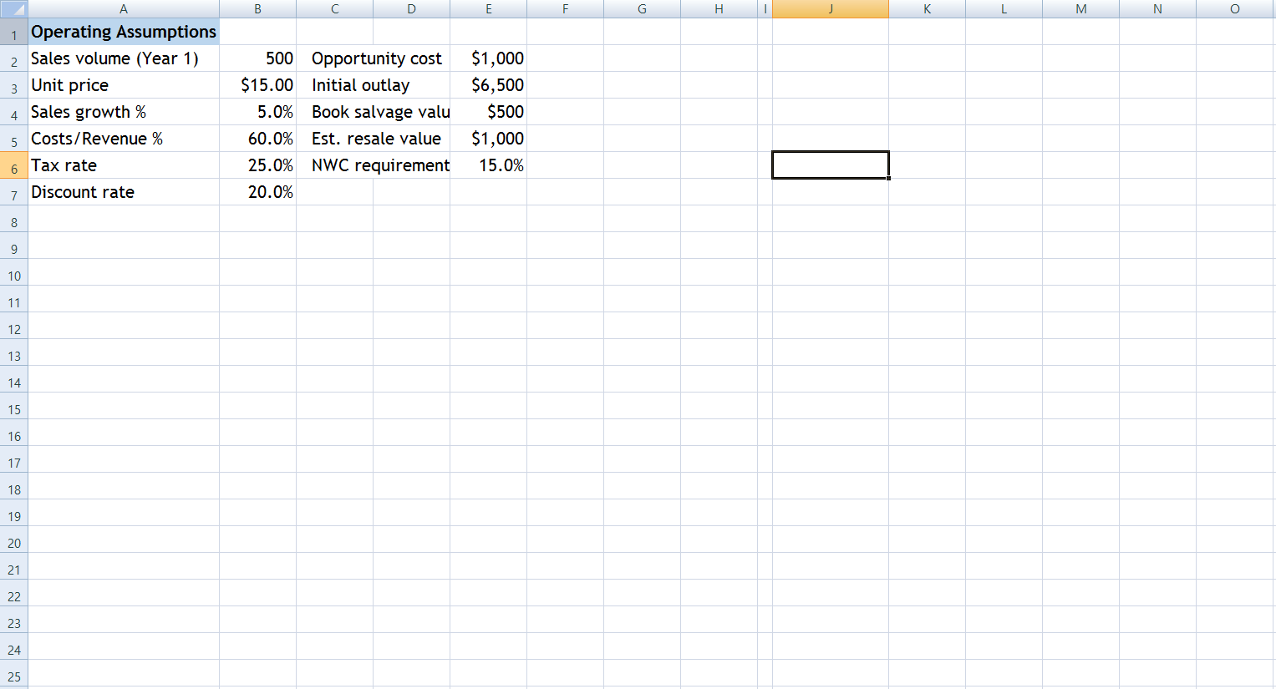

Slide 13
Development cost of $5,000?

Slide 14
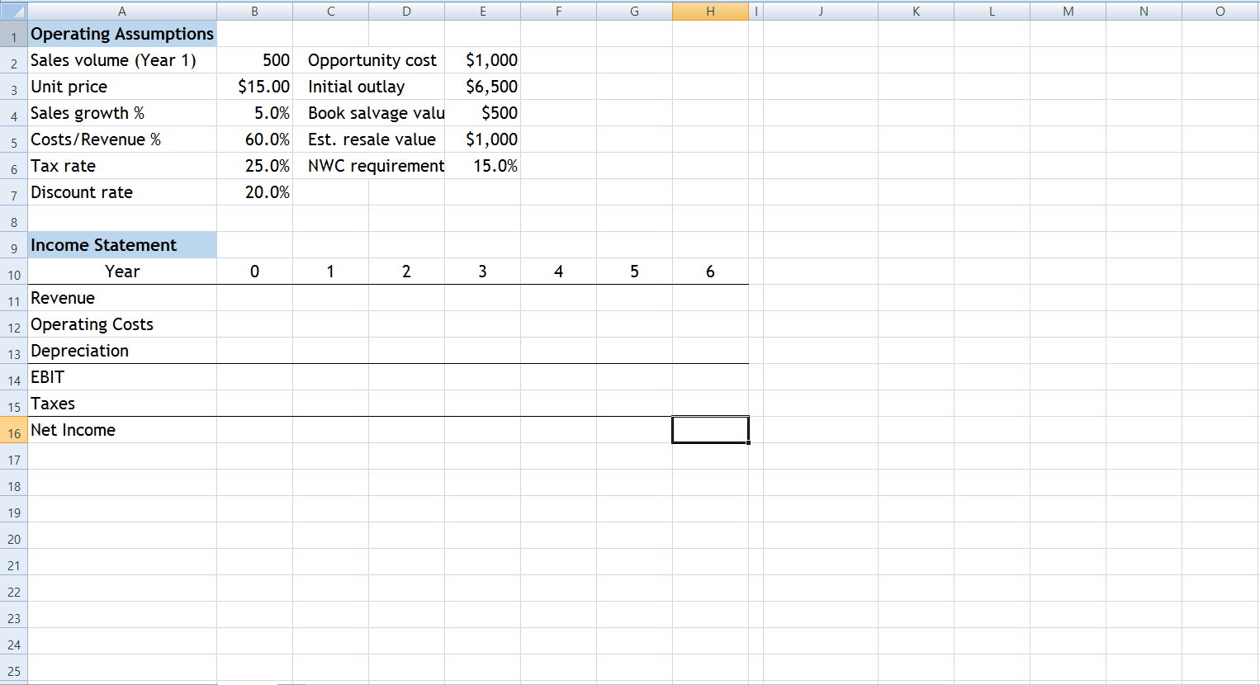

Slide 15
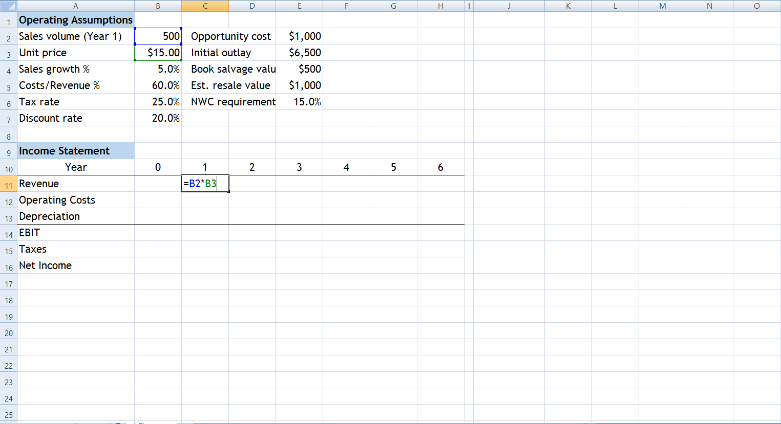

Slide 16
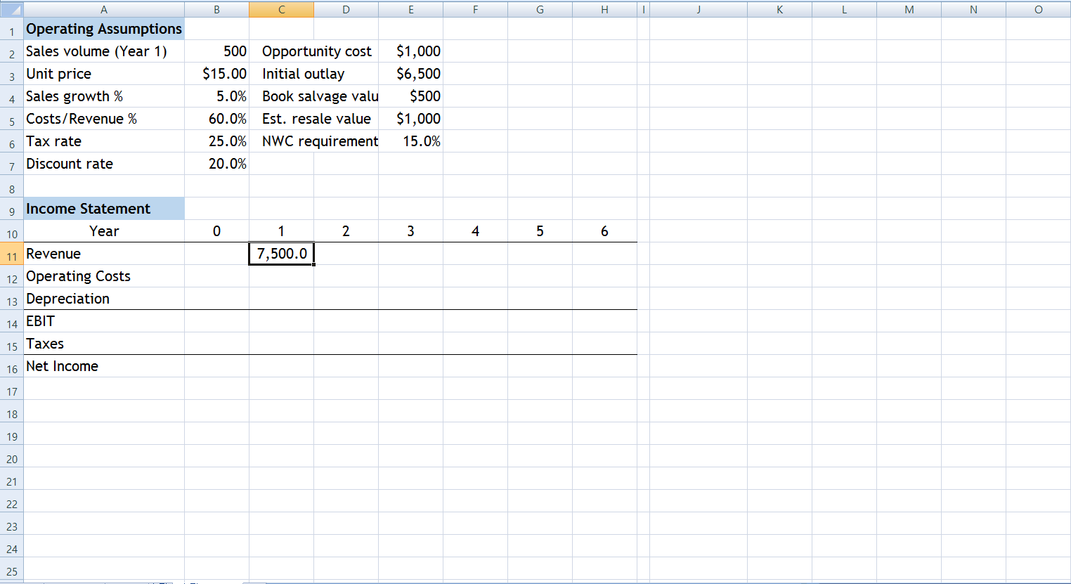

Slide 17
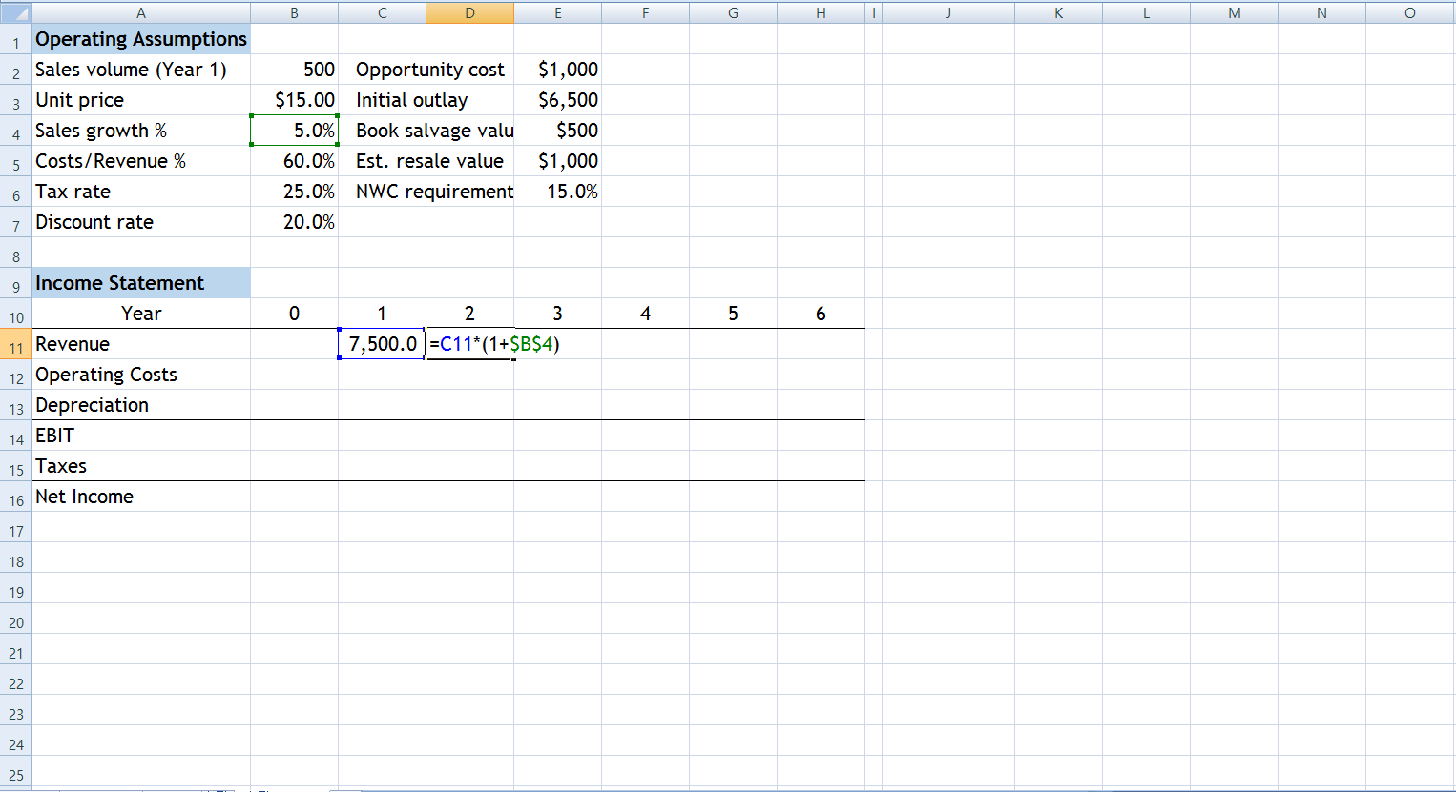

Slide 18
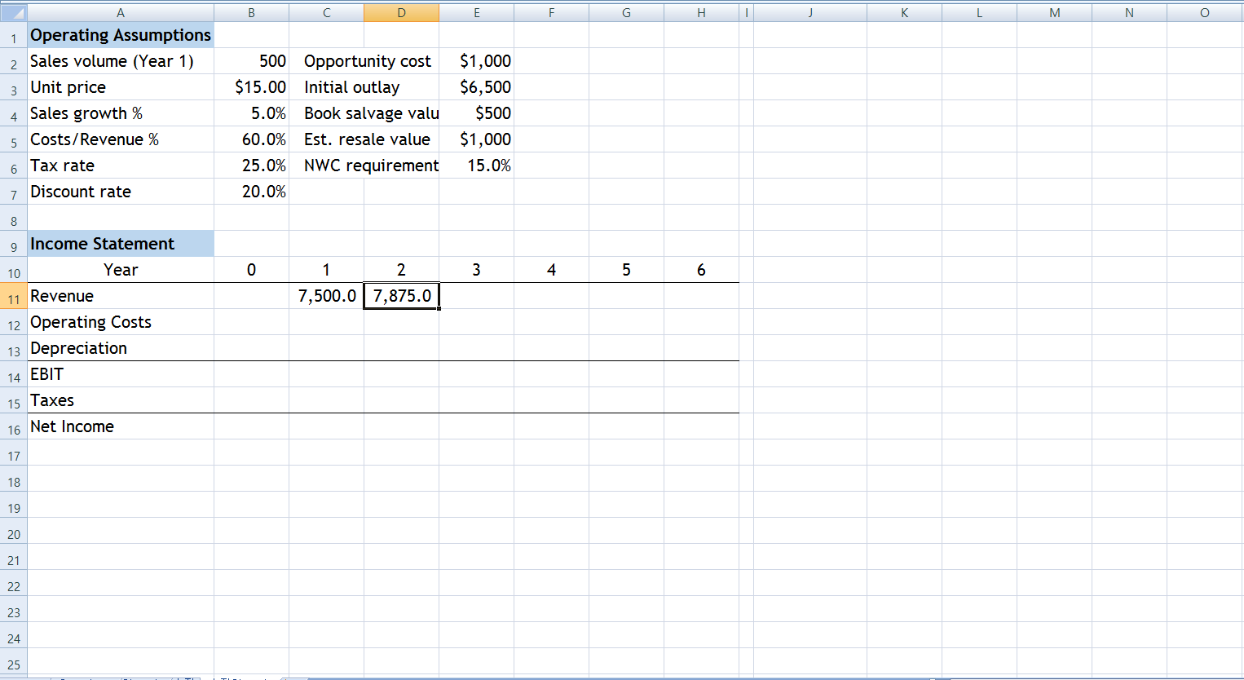

Slide 19
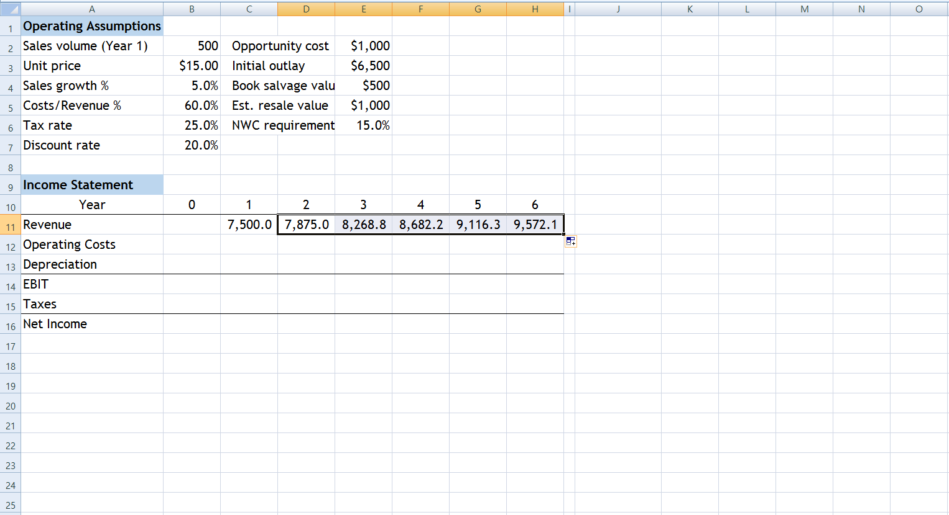

Slide 20
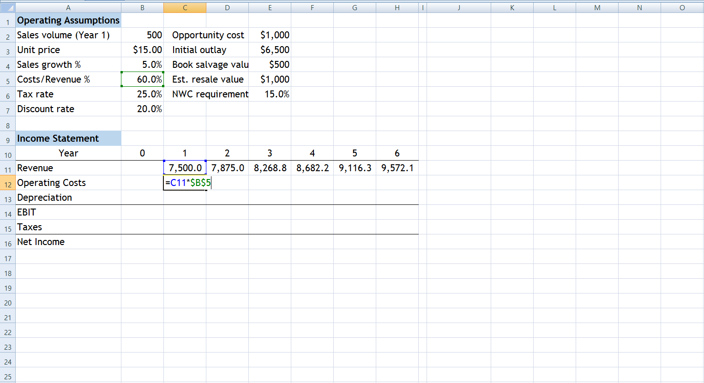

Slide 21
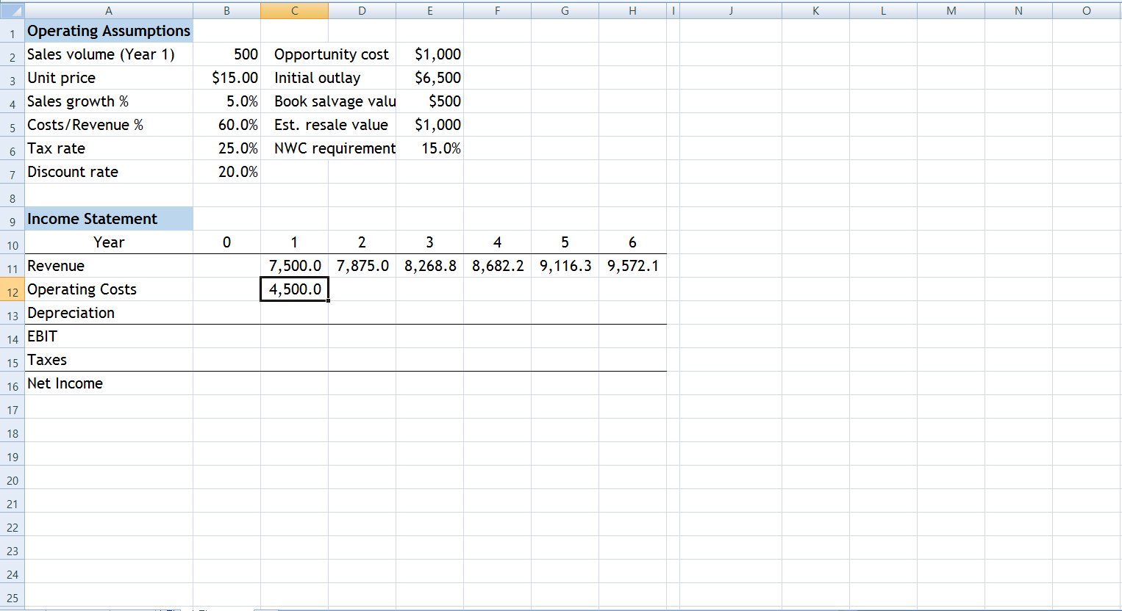

Slide 22
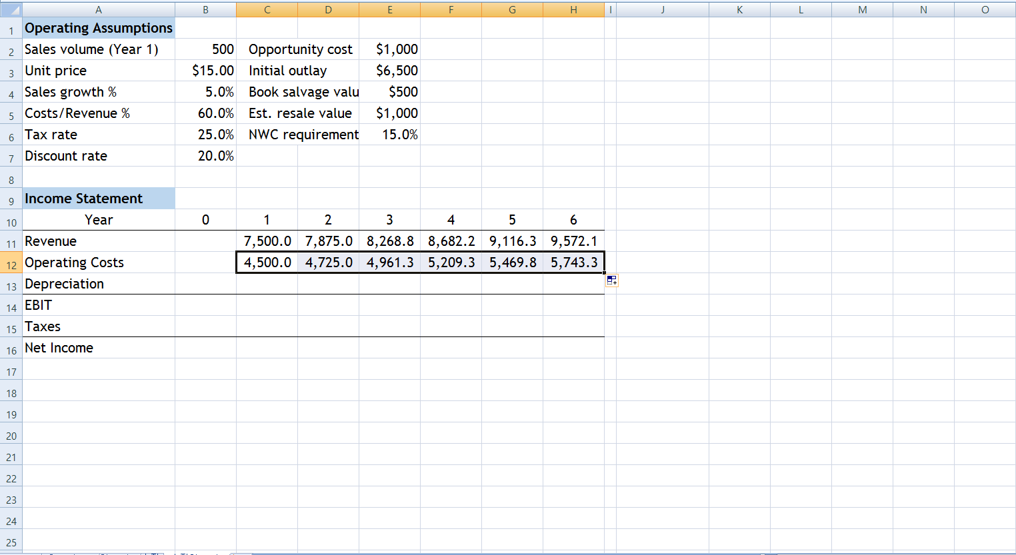

Slide 23
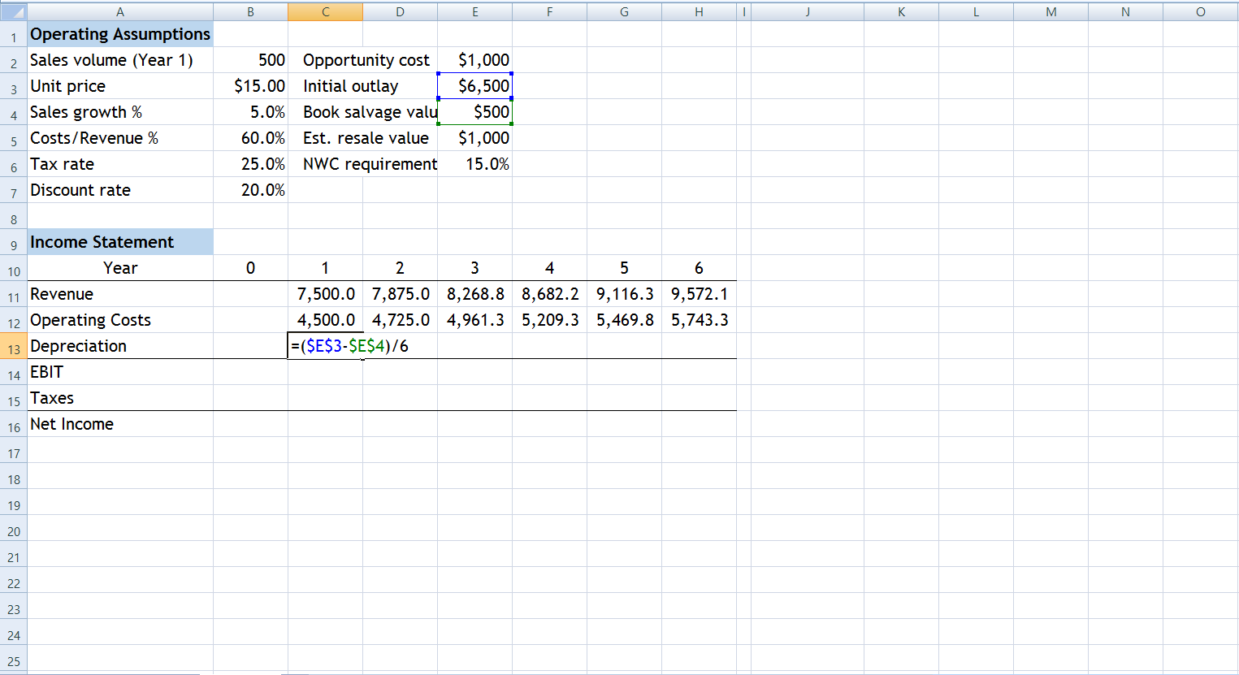

Slide 24
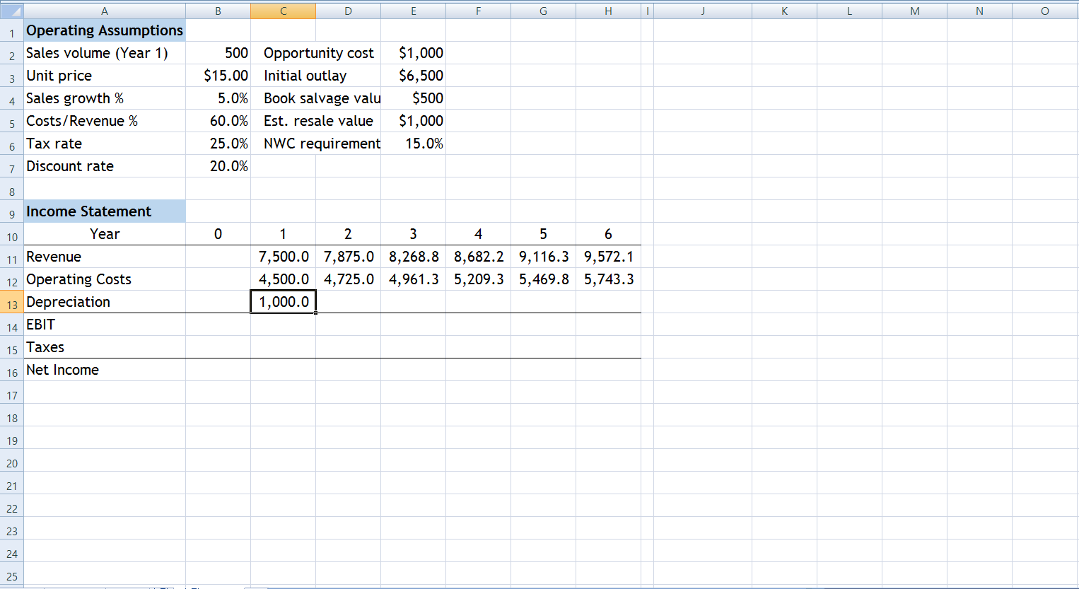

Slide 25
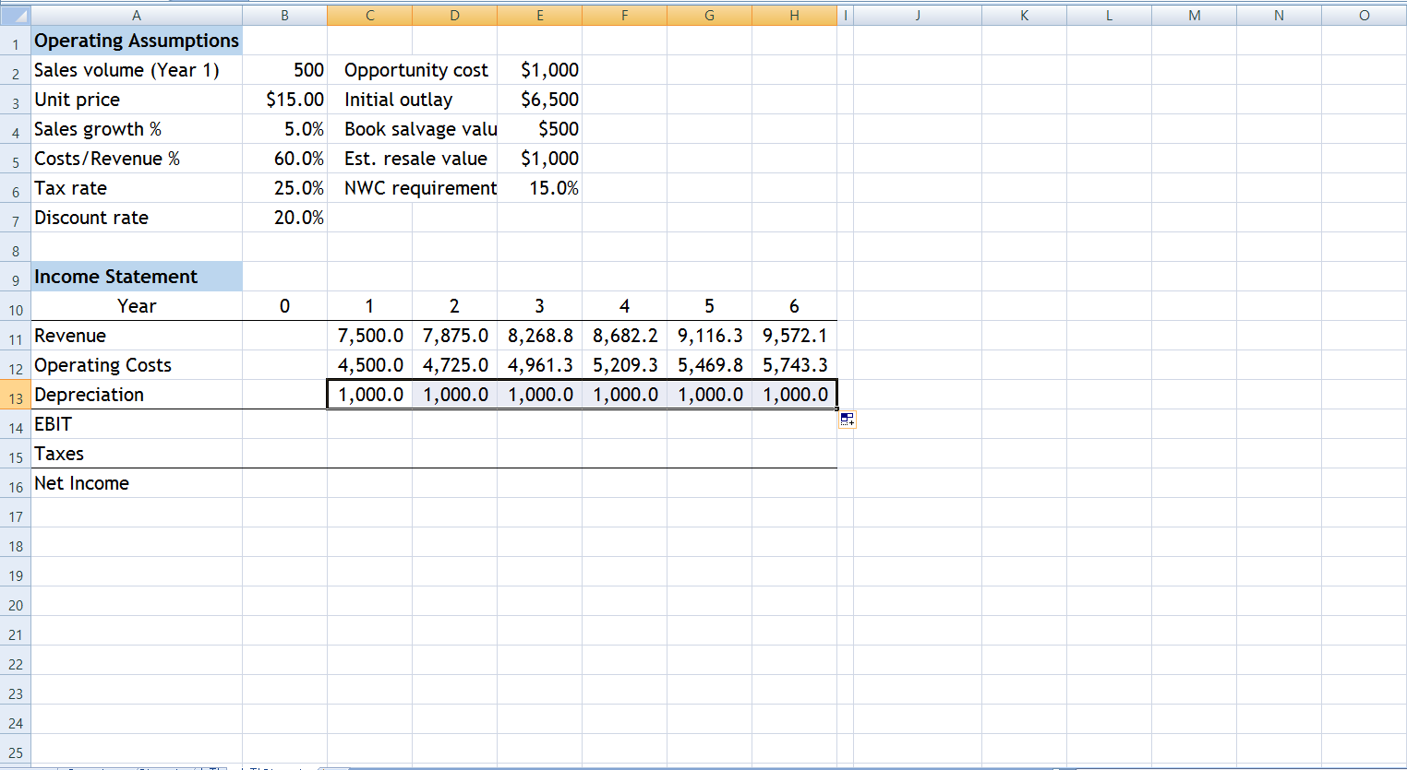

Slide 26
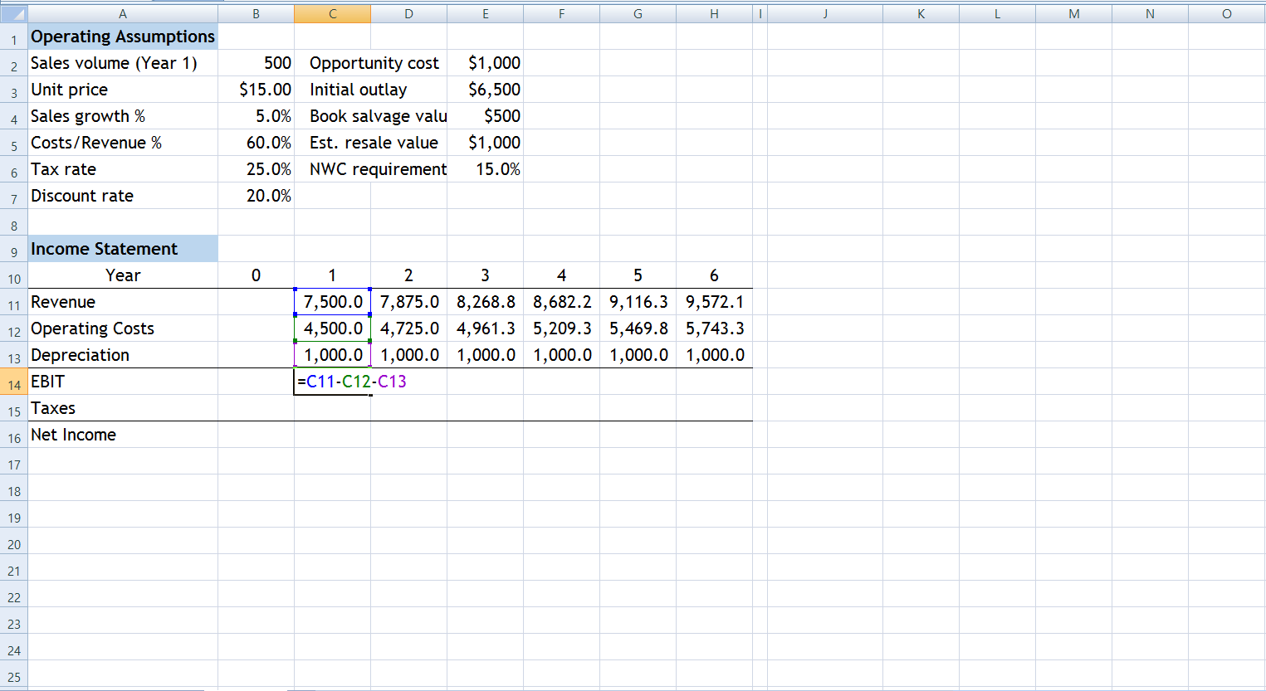

Slide 27
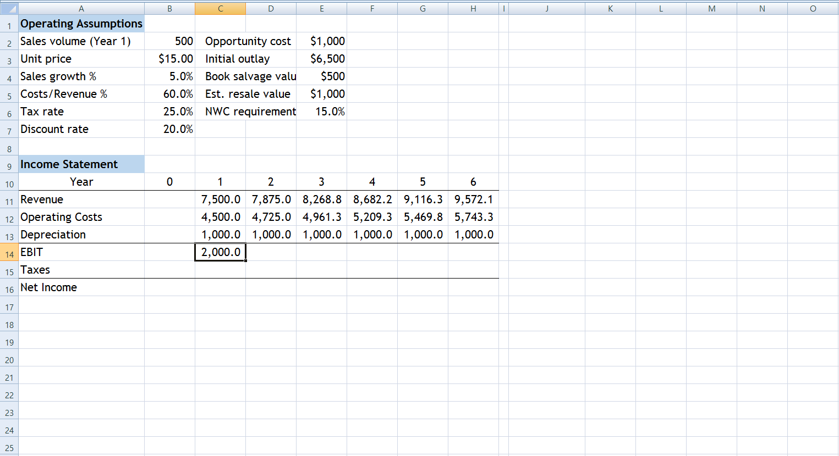

Slide 28
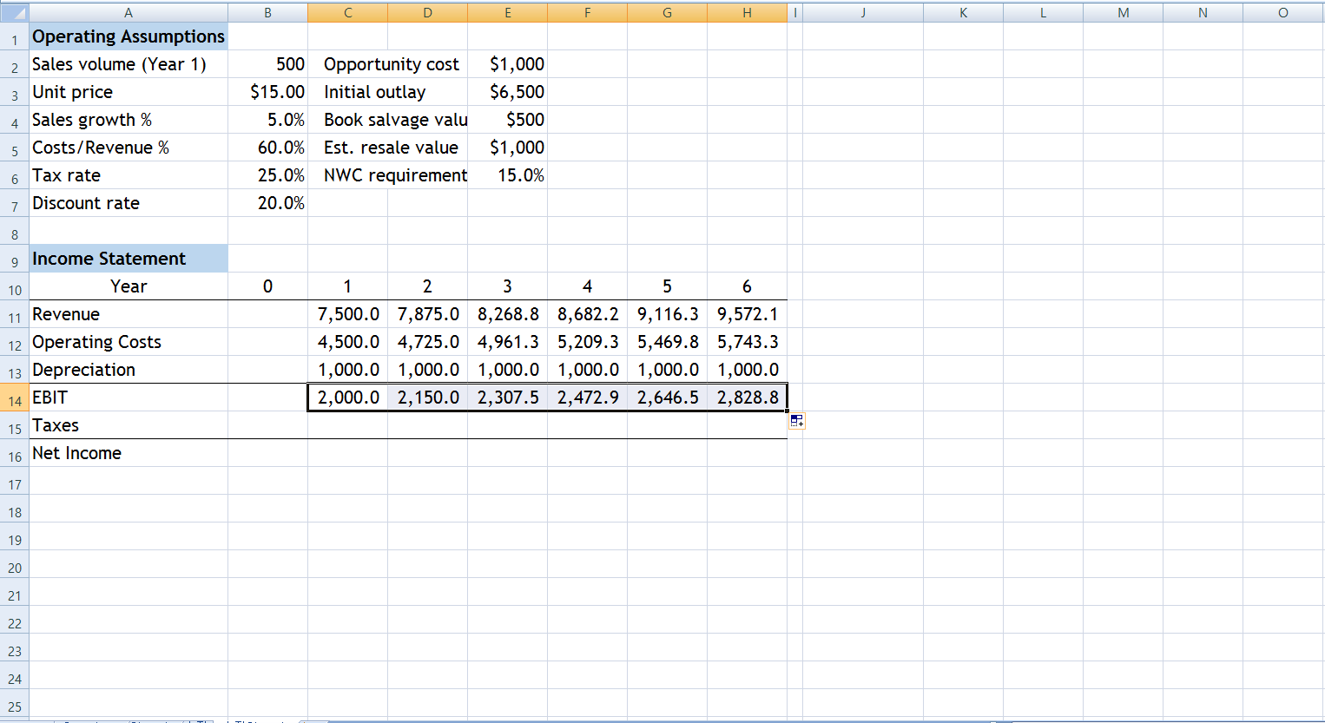

Slide 29
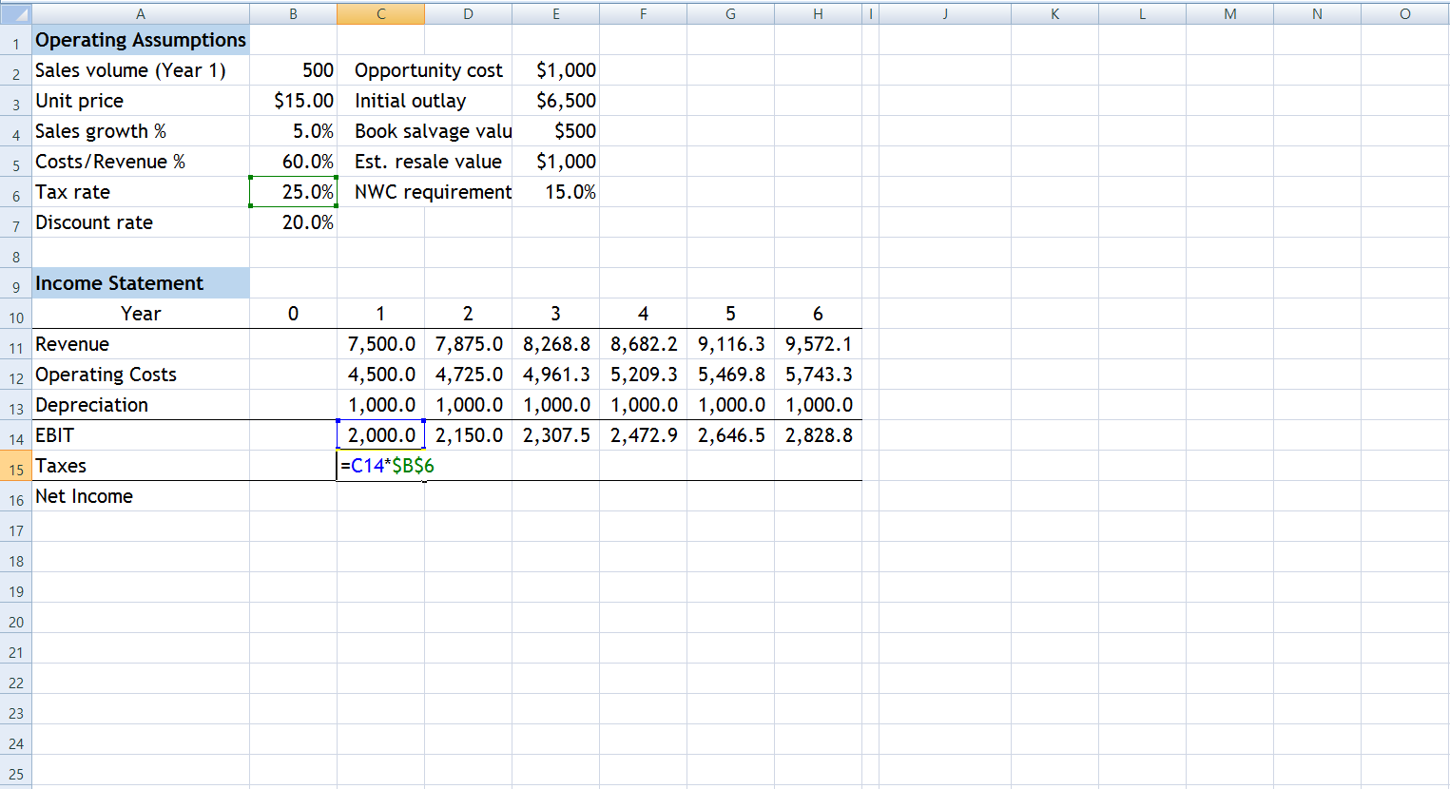

Slide 30
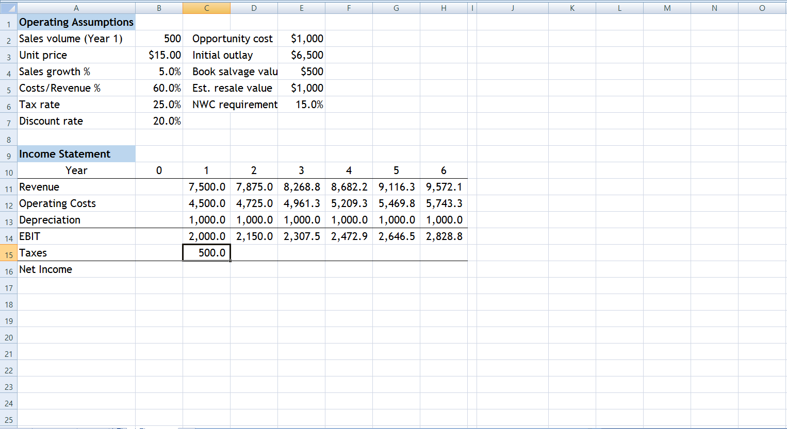

Slide 31
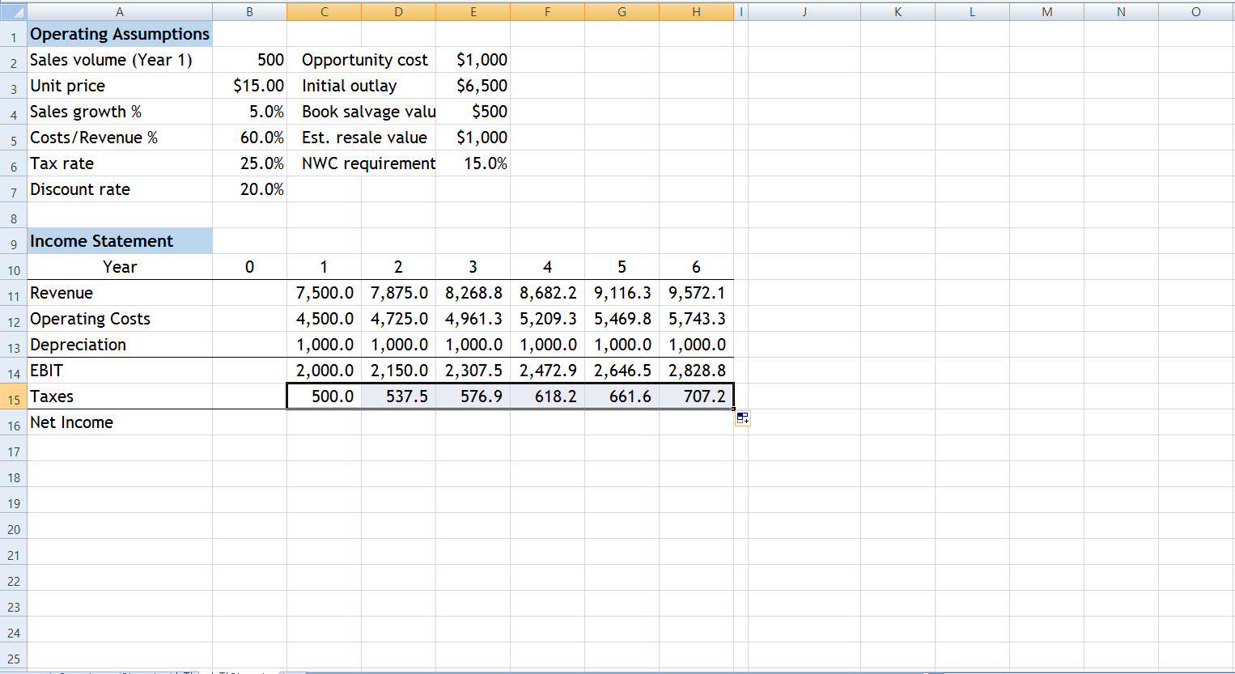

Slide 32
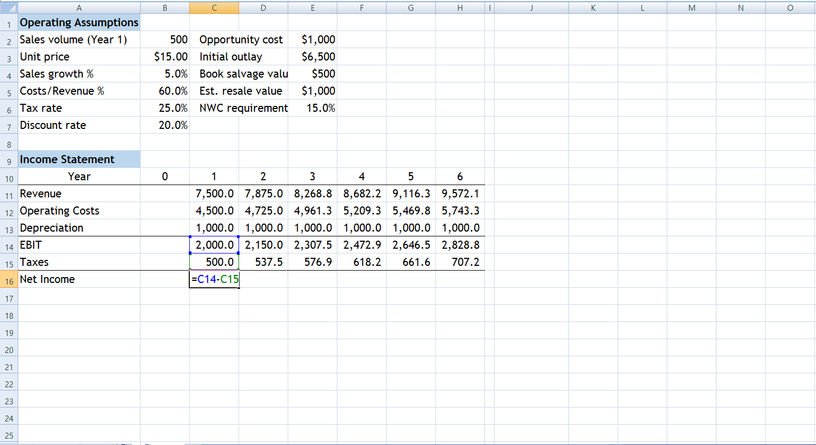

Slide 33
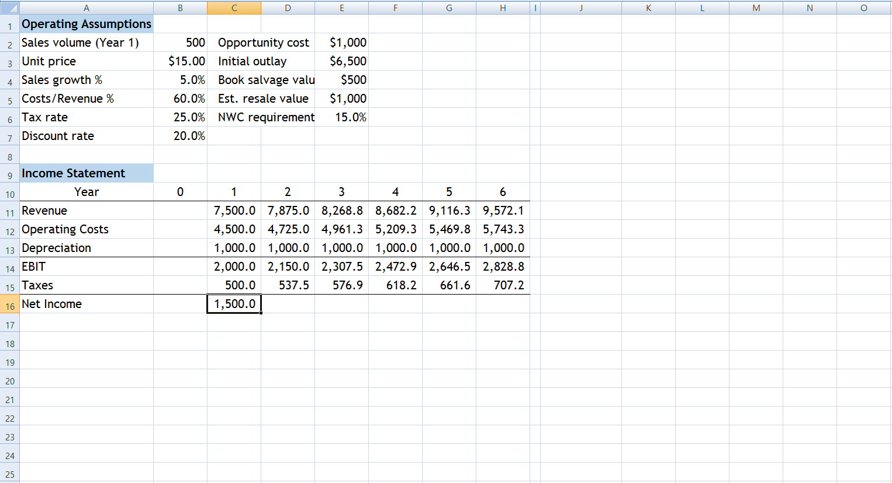

Slide 34
